Slide 1




Introduction to PyTorch - 1
Mustafa Mert Tunalı
MEF University / A202
November 3, 2022

Slide 2

Contents
How are models trained?
Neural Networks
Convolutional Neural Networks (CNN)
Tensors
Datasets & DataLoaders
Transforms
Building the Model
Optimizing Model Parameters
Model Deployment

Slide 3
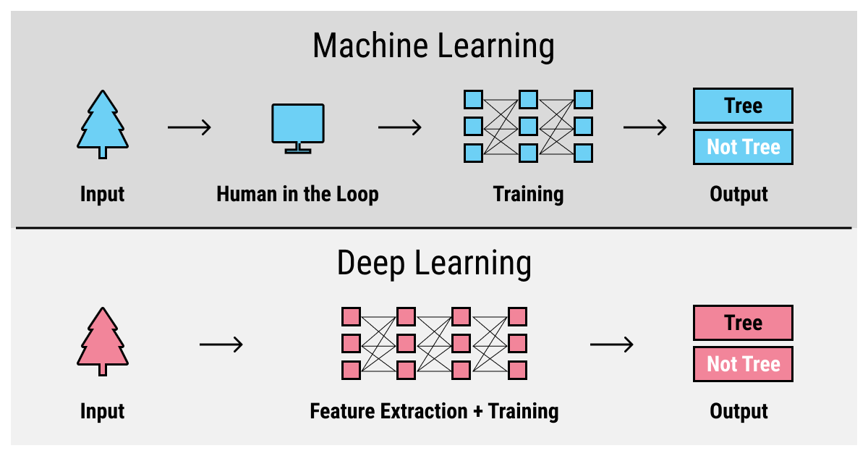
How Are Models Trained?

Slide 4
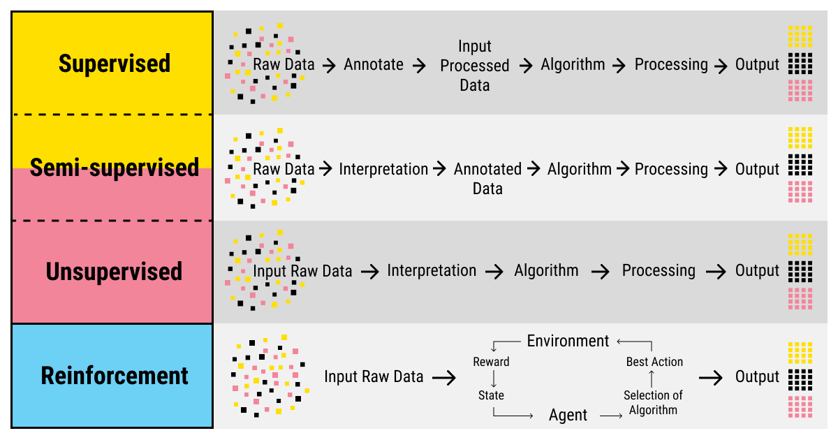
How Are Models Trained?
Supervised: Labeled Data
Semi-supervised: Cluster + Labeled Data
Unsupervised: Unlabeled Data
Reinforcement: Award based system.
We are going to focus on supervised learning.

Slide 5
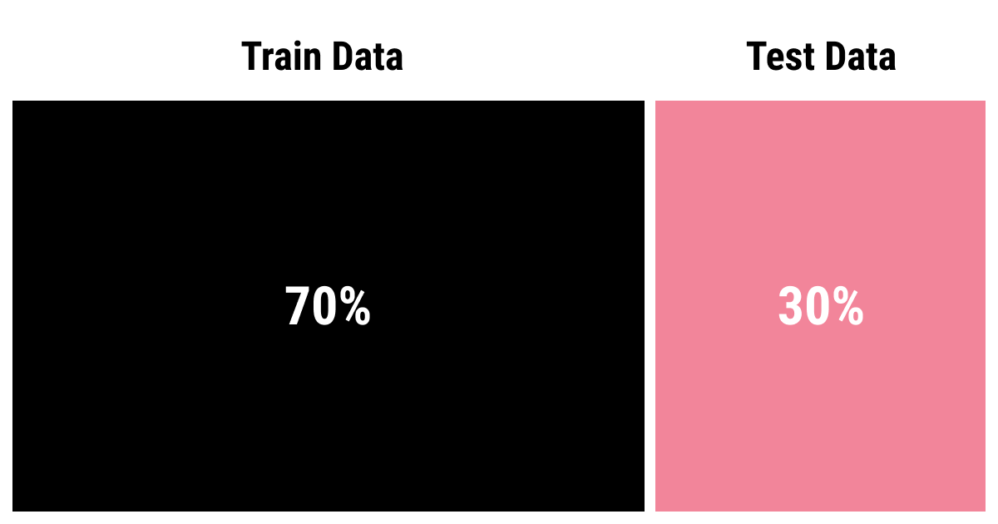
How Are Models Trained?
Other split examples:
Scenario 1:
Train: 70%
Validation: 15%
Test: 15%
Scenario 2:
Train: 80%
Validation: 10%
Test: 10%
Scenario 3:
Train: 70%
Validation: 15%

Slide 6
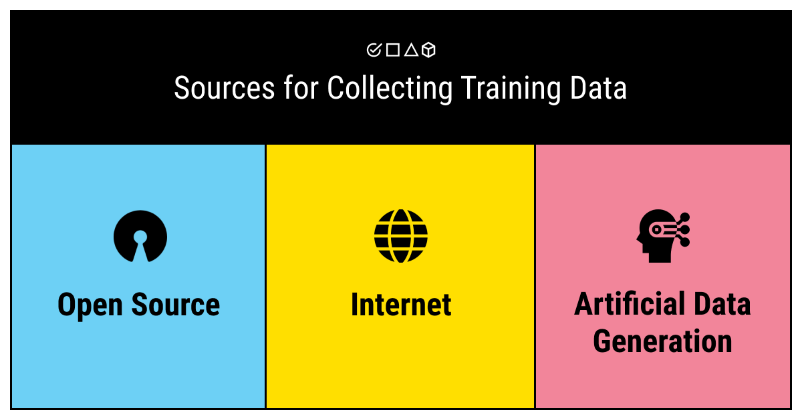
How Are Models Trained?
Before collecting data you should:
Define the problem.
Identify the needs.
Collect the data based on the needs.

Slide 7

How Are Models Trained?
Problem Definition
Data Collection
Model Training
Model Evaluation
Model Deployment
Source: Microsoft

Slide 9
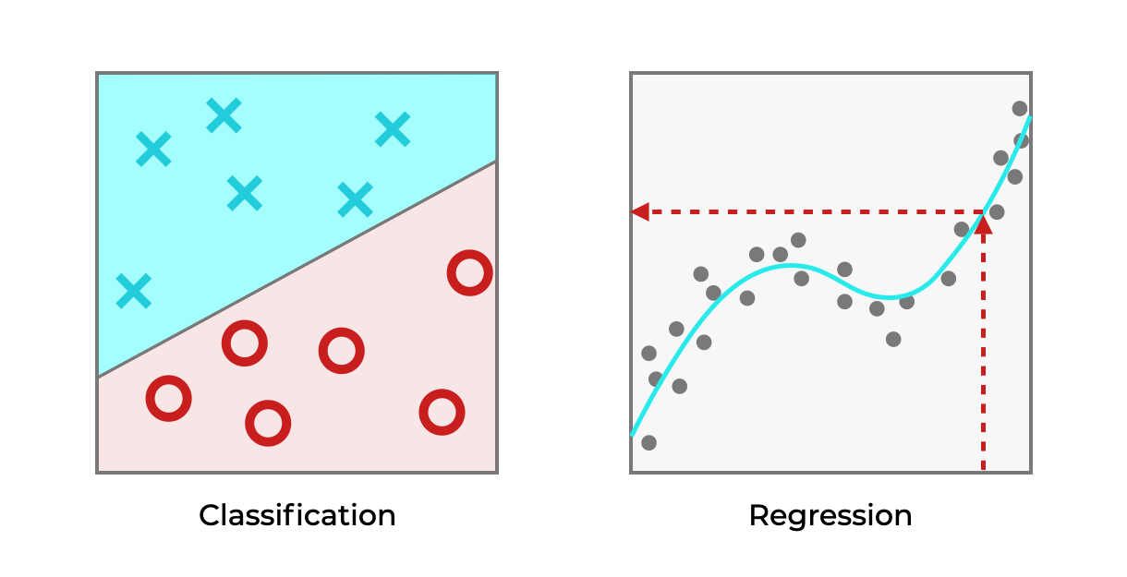
How Are Models Trained?
Supervised Learning:
Classification:
Nearest Neighbor
Decision Trees
Linear Regression
Support Vector Machines (SVM)
Neural Networks
Regression
Linear Regression
Random Forest
Support Vector Regression

Slide 10
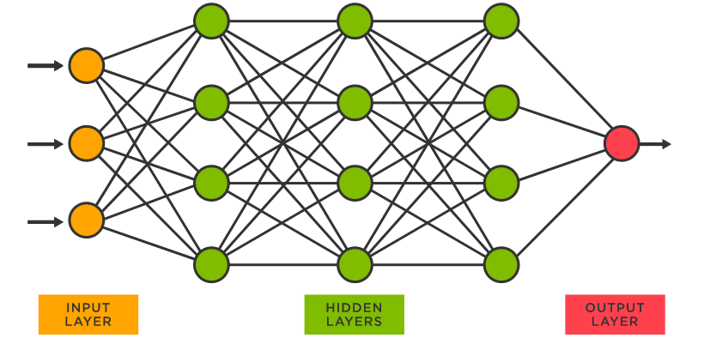
Neural Networks
What is a neural network and artificial neural network?
It began with Warren McCulloch and Walter Pitts (1943).
By the 1956, Marvin Minsky explained AI as a term at Dartmouth College.
ANNs contain an input layer, hidden layer, and output layer,
Weight and threshold on the connection.

Slide 11
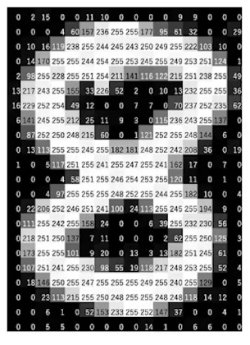
Neural Networks

Slide 12
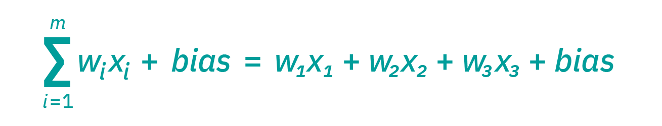
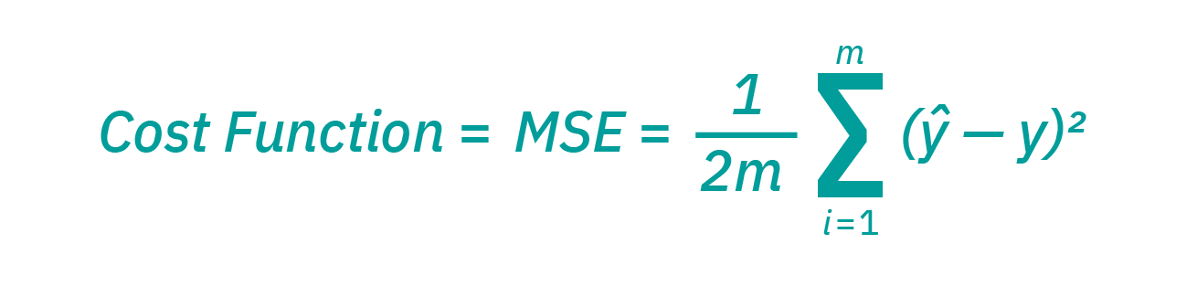
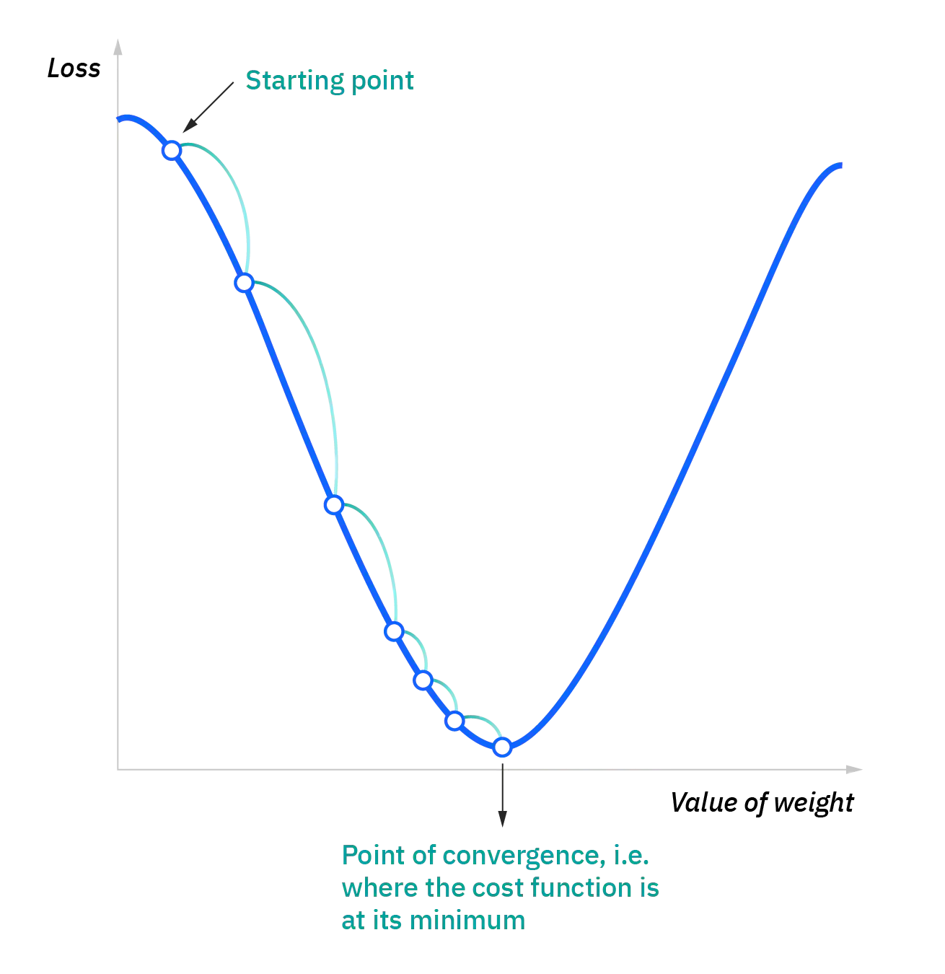
Neural Networks
Every node has input data, weights, a bias or threshold, and output.
Node’s weight changes depend on cost function.
i represents the index of the sample
Y-hat is the predicted one
Y is the actual value
M is the number of samples

Slide 13
Neural Networks
Minimize the loss.
Update weights.
Calculate the loss.
Update weights.
End it WHEN?

Slide 14
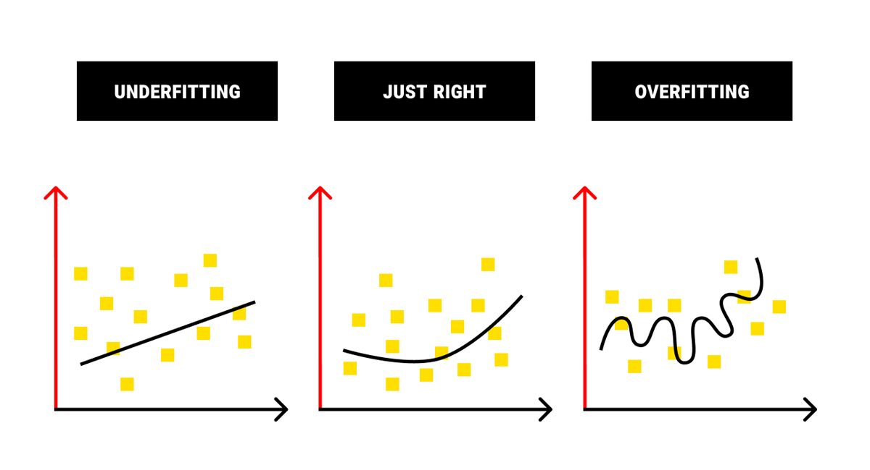
Neural Networks

Slide 15
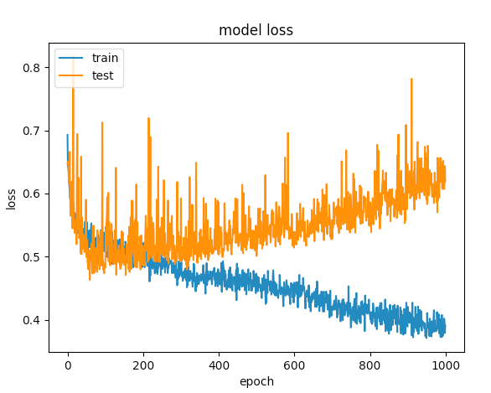
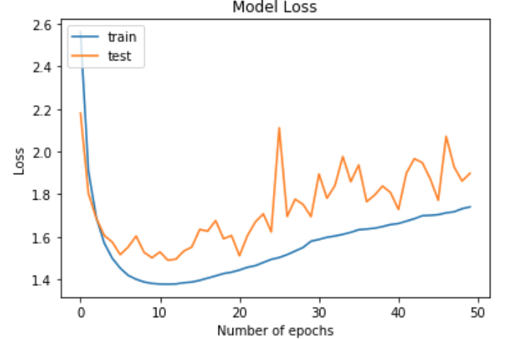
Neural Networks

Slide 16
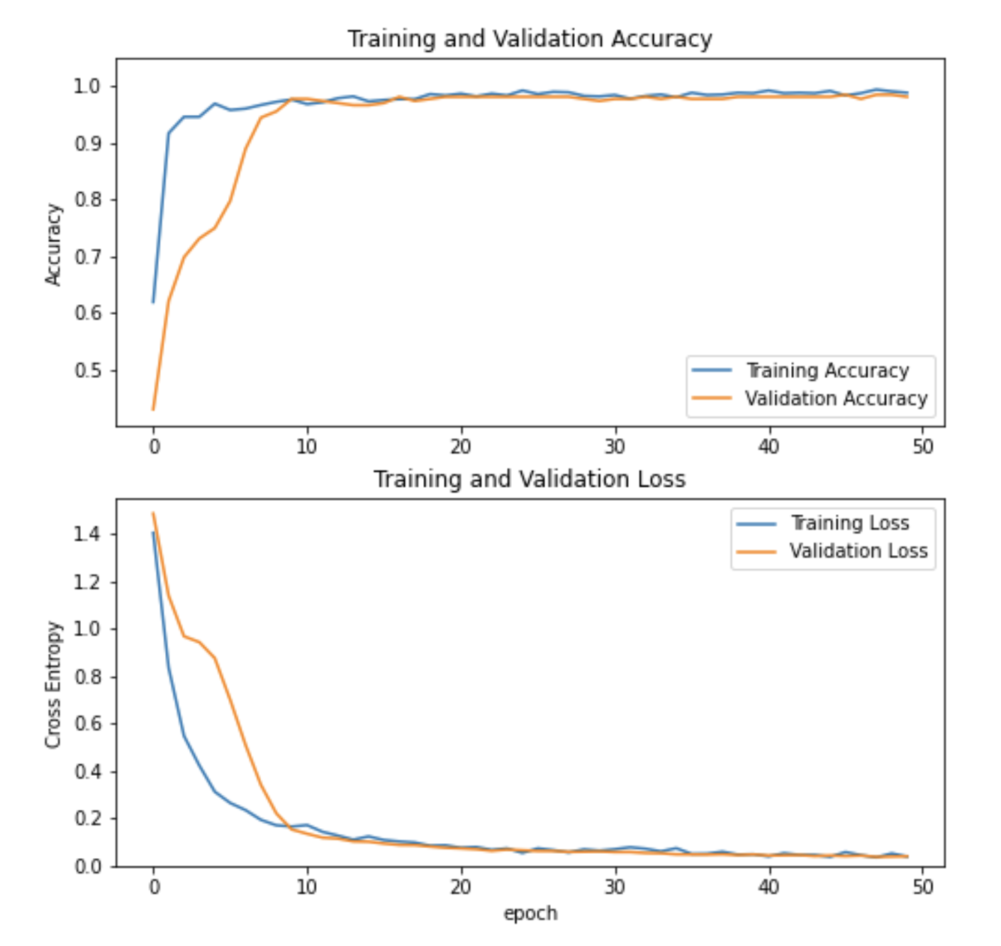
Neural Networks
Accuracy:
M. M. Tunali, A. Yildiz and T. Çakar, "Steel Surface Defect Classification Via Deep Learning," 2022 7th International Conference on Computer Science and Engineering (UBMK), 2022, pp. 485-489, doi: 10.1109/UBMK55850.2022.9919470.
Loss

Slide 17
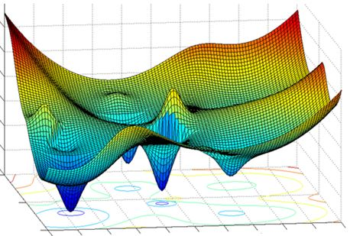
Neural Networks
Hyper-parameters:
Learning Rate
Optimizer
Epoch
Activation Functions
Dropout
Number of neurons

Slide 18

Neural Networks
Hyper-parameters:
Learning Rate
Optimizer
Epoch
Activation Functions
Dropout
Number of neurons

Slide 19
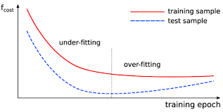
Neural Networks
Hyper-parameters:
Learning Rate
Optimizer
Epoch
Activation Functions
Dropout
Number of neurons

Slide 20

Neural Networks
Hyper-parameters:
Learning Rate
Optimizer
Epoch
Activation Functions
Dropout
Number of neurons

Slide 21
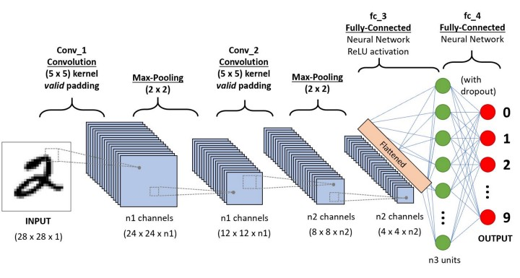
Convolution Neural Networks

Slide 22


Convolution Neural Networks
An image may contains:
RED, GREEN, BLUE
GRAY
HSV (hue, saturation, value)

Slide 23

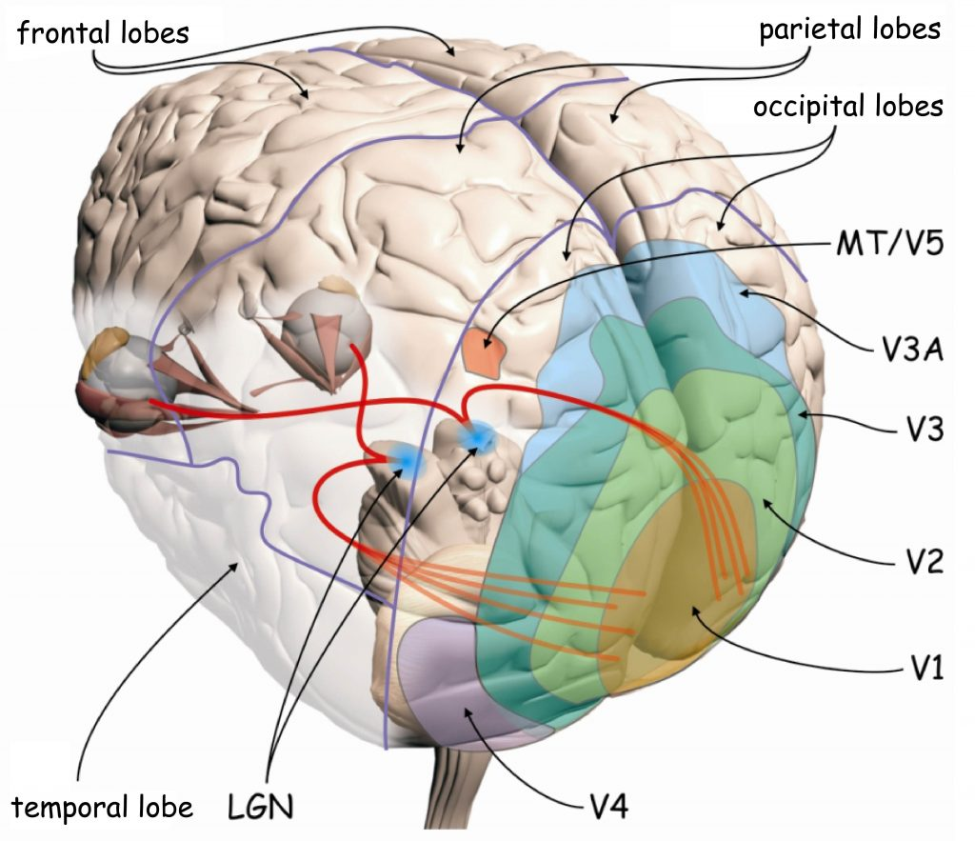
Convolution Neural Networks

Slide 24


Convolution Neural Networks

Slide 25
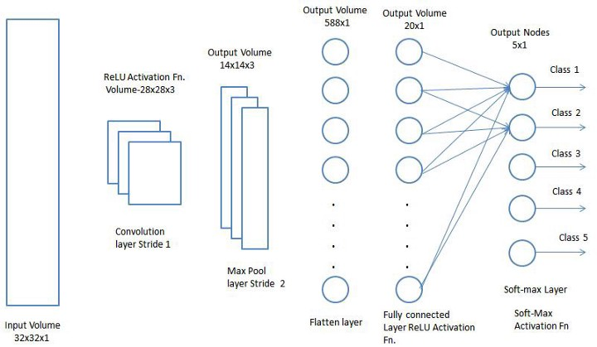
Convolution Neural Networks

Slide 26
Coding Time!
Tensors
Datasets & DataLoaders
Transforms
Building the Model
Optimizing Model Parameters
Let’s code and learn:

Slide 27
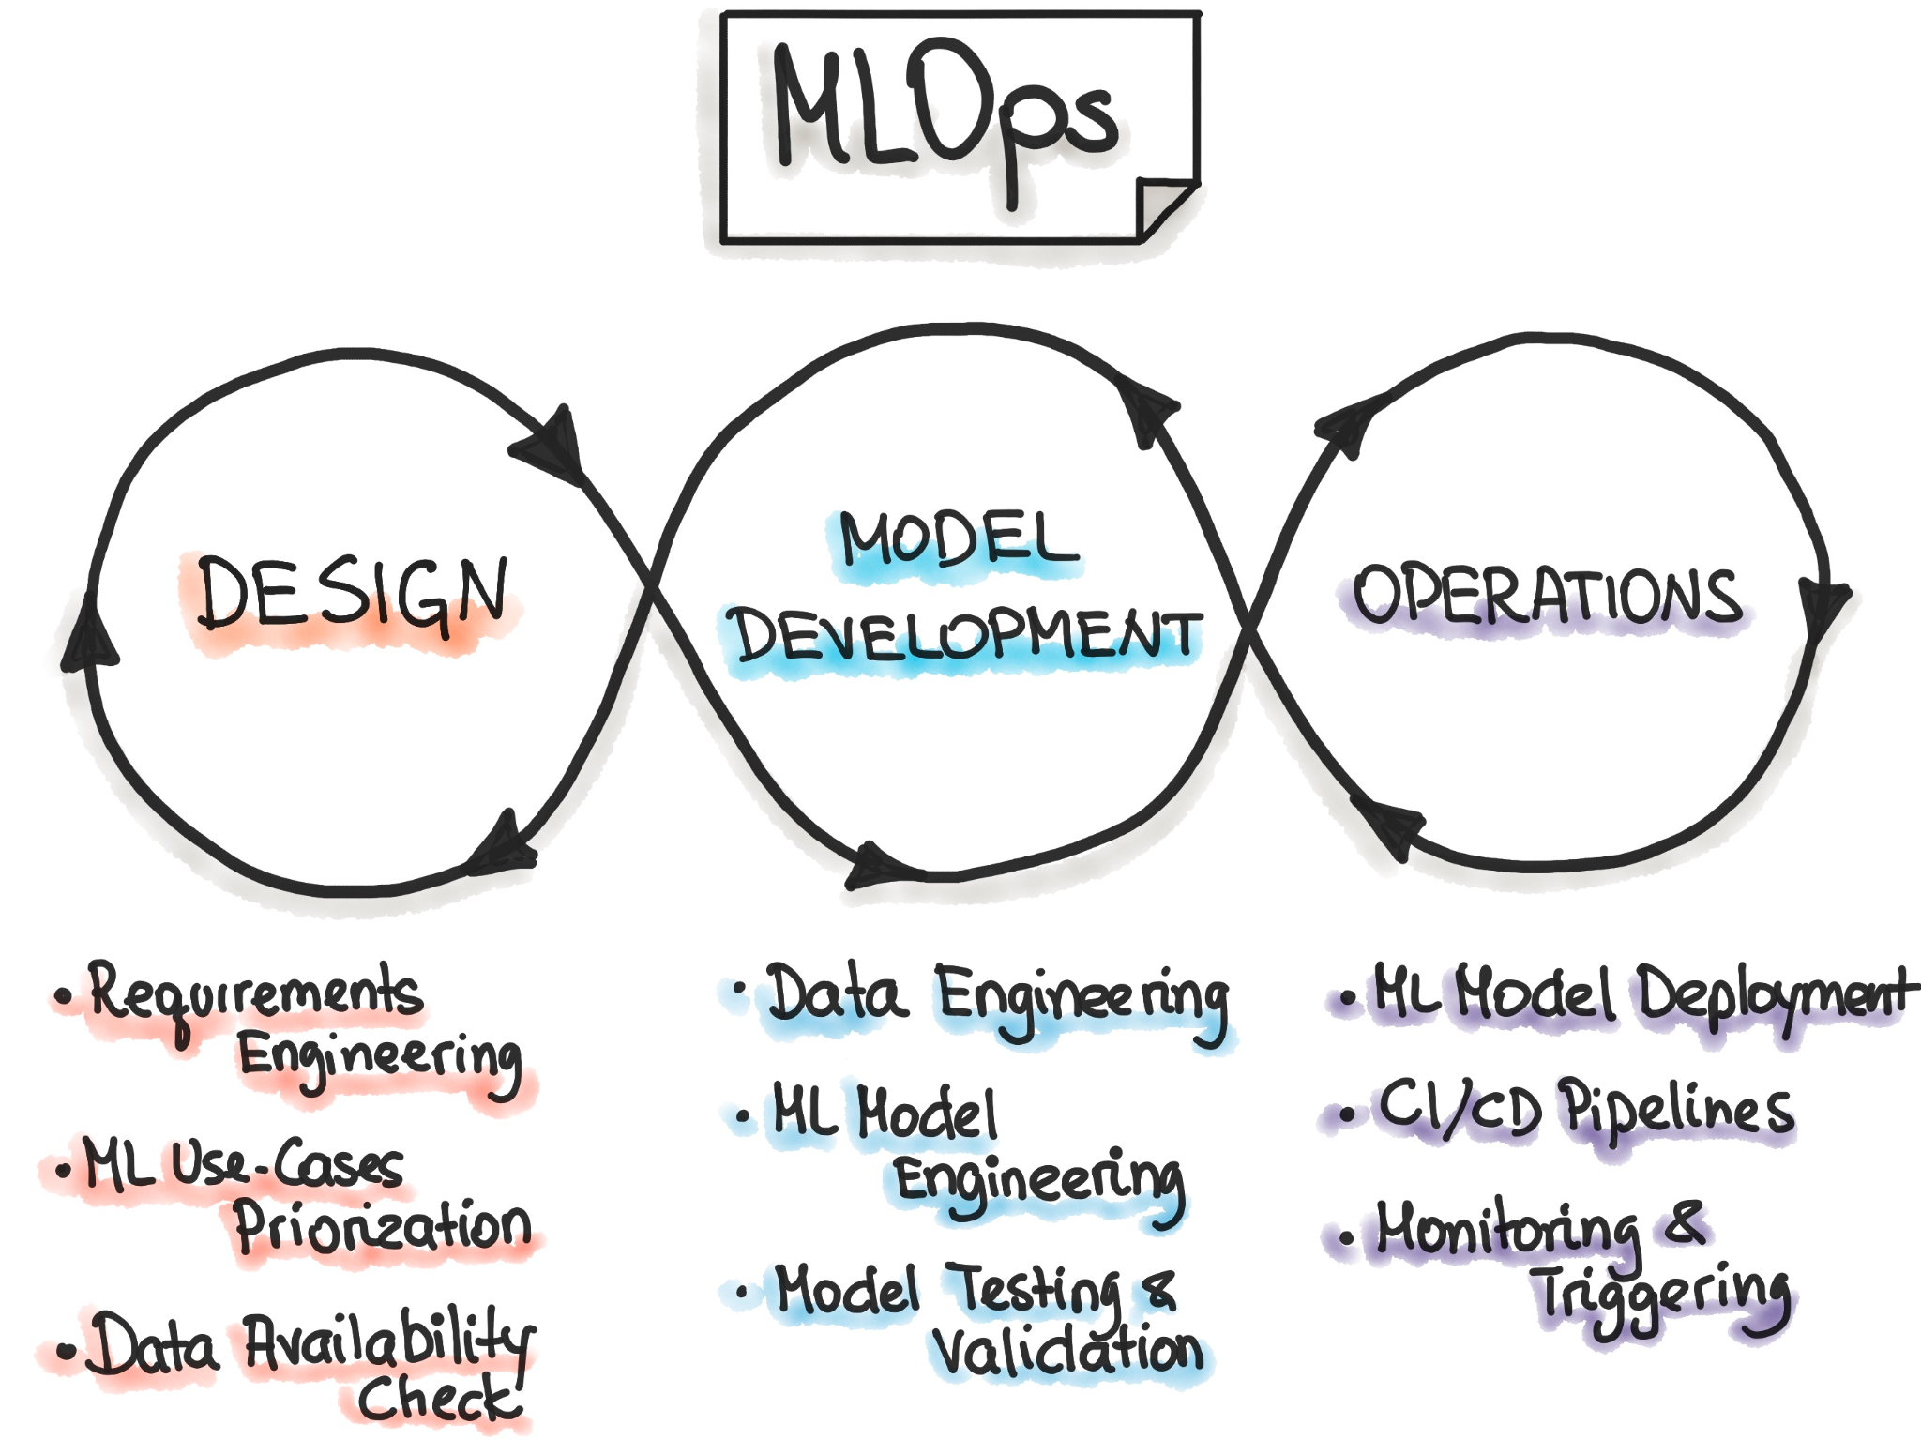
Model Deployment
How to deploy trained model?
Inference the model on Cloud or Embedded Systems.
How to monitor its performance?
CI/CD Pipelines
Docker, Docker-Compose and Kubernetes
Amazon Web Services (AWS)
Google Cloud

Slide 28
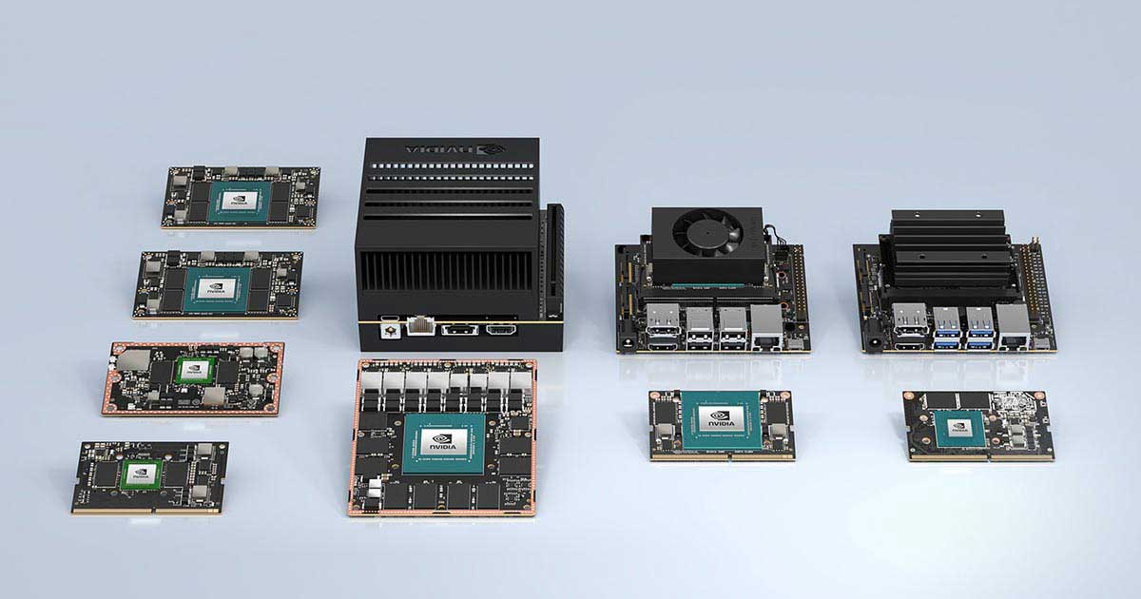




Model Deployment
Inference the model on Cloud or embedded platforms.

Slide 29
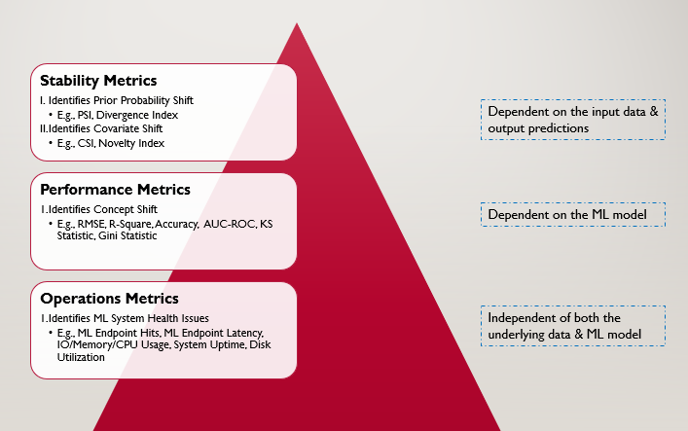
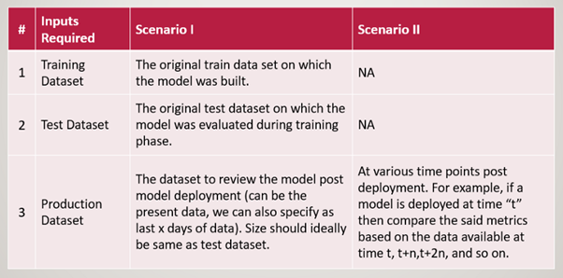
Model Deployment
How to monitor the performance?

Slide 30
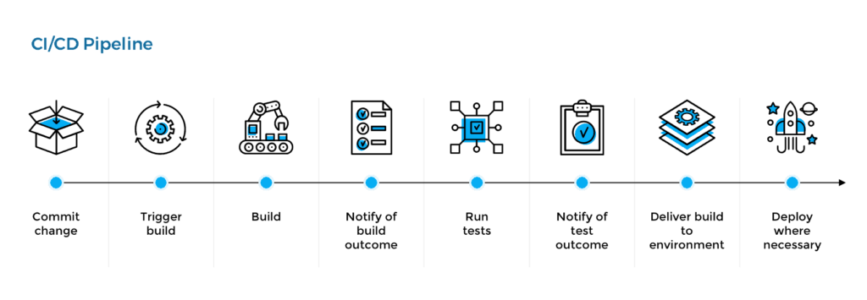
Model Deployment

Slide 31

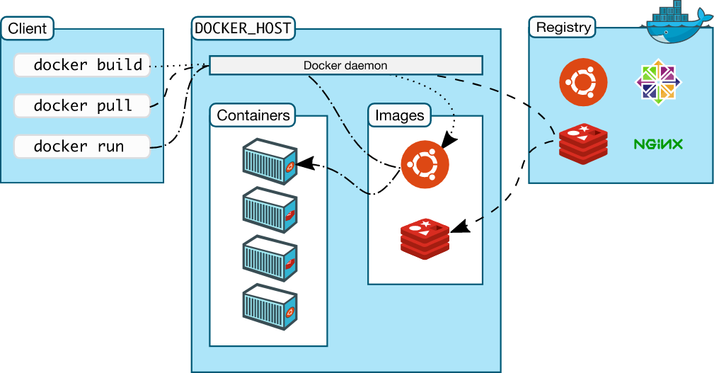
Model Deployment

Slide 32
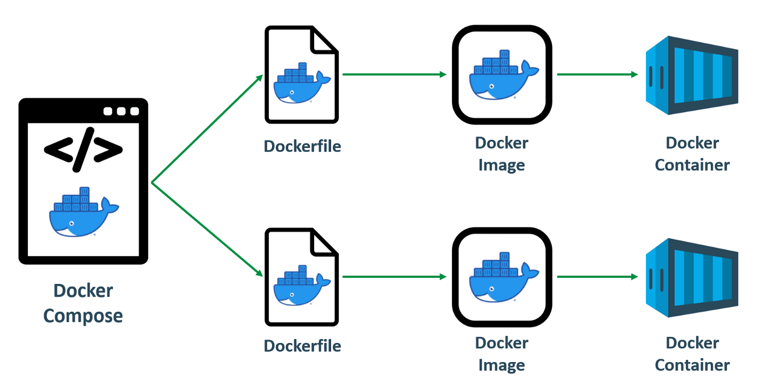
Model Deployment

Slide 33

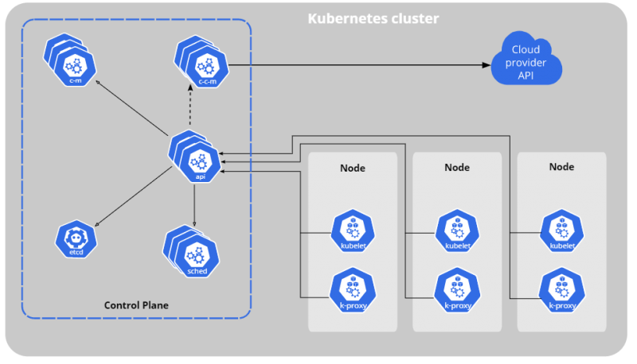
Model Deployment

Slide 34

Model Deployment
VS

Slide 35
BONUS

Slide 36


How to learn more about AI?
https://www.coursera.org/specializations/machine-learning-introduction
https://www.coursera.org/specializations/deep-learning

Slide 37
Thank you for listening!

